Slide 1
Music Genre Classification
Based On Lyrics

Slide 2
Agenda:
01
04
Introduction
Models Results
02
05
Purpose of Project
Conclusion/Integrating the model
03
06
Methodology
Recommendations

Slide 3
1- Introduction
01
The music industry has become an integral part of society's lifestyle in several countries.
02
Digital music streaming has led to the need for genre classification based on lyrics.
03
The Music genre classification is a significant research topic in the field of music information retrieval
04
Multi-genre classification is even more challenging than single-genre classification
05
Lyric-based genre classification is one approach that considers textual information to enhance classification accuracy

Slide 4
2-Purpose of Project
Predict the genre of a song using its lyrics

Slide 5
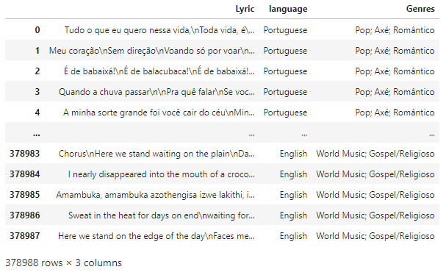
Full DataSet

Slide 6
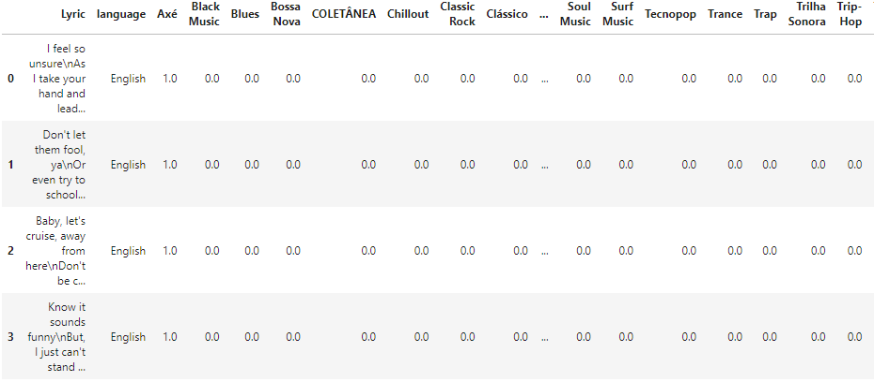
Pre-Processing Genre Column: MultiLabel-Binarizer

Slide 7
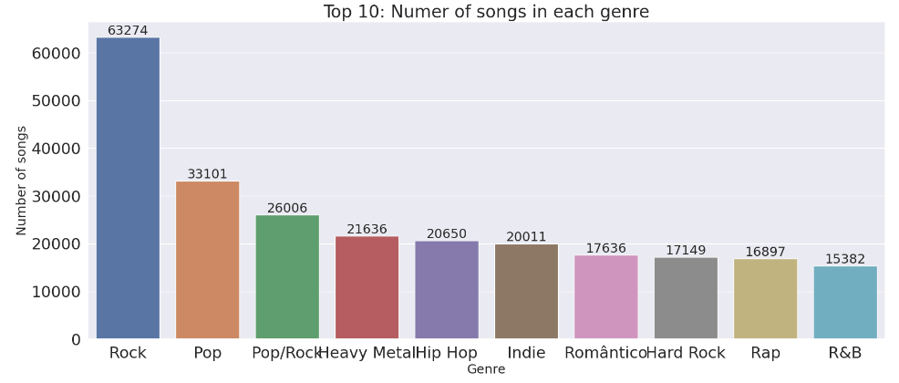
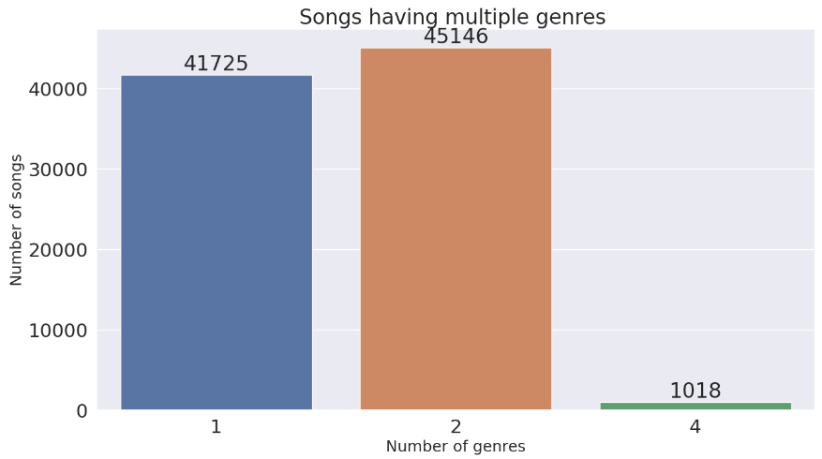
Exploratory Data Analysis

Slide 8
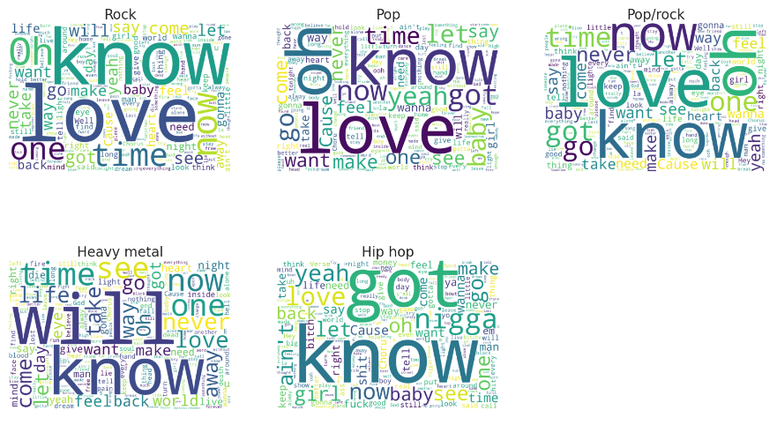
Sample: 5000 Rows – Top 5 Genre

Slide 9
Preprocessing of the Lyrics Column
Removing Stop Words
THE/AND/WHERE/CAN…
Sample:
5000 Rows – Top 5 GENRE
Special Characters
!/%/&…
Tokenization
SENTENCE-> WORDS
Stemming
STEMMING-> STEM

Slide 10
Feature Engineering
Sample:
5000 Rows – Top 5 GENRE
TFIDF Vectorizer
Initialized and transformed on the lyrics

Slide 11
Multi-Label Classification Estimators
What is the difference between multi-class and multi-label classification problems?
Label Powerset:
03
Transforms the problem to a multi-class classification by giving a unique class for every unique combination of genres
Classifier Chains
02
Forms classifier chain that preserves the label correlations
Binary Relevance
01
treats each label as a separate binary classification task.

Slide 12
Machine Learning Models
We applied each of the three multi-label estimators on the following ML models
Multinomial Naïve Bayes
Guassian Naïve Bayes
Random Forest Classifier
K Nearest Neighbors
Logistic Regression
XGboost
18 models

Slide 13
Deep Learning Models
We applied the following Deep Learning Models
BERT
Bidirectional Encoder Representation from Transformers
MLP
2 DL models

Slide 14
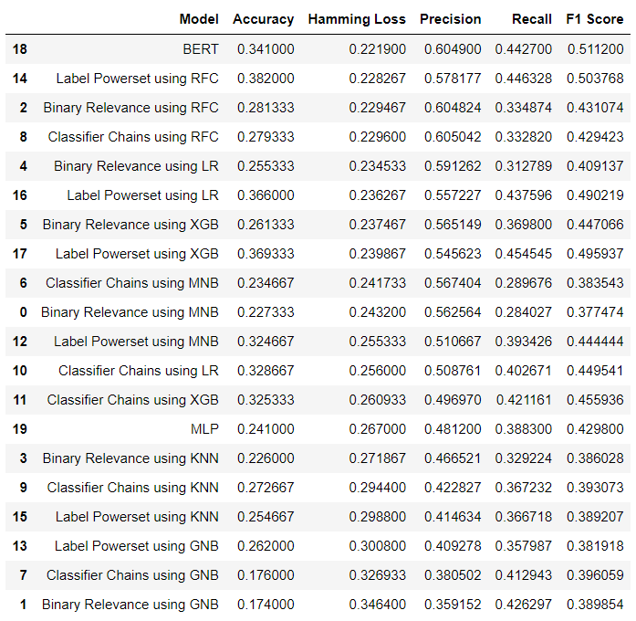
Machine Learning Results

Slide 15
Recommendations
Room for improvement in accuracy results by:
- Sampling to cover for the label imbalance
- Hyper parameter tuning
- Using a larger subset of the data
- Stacked models for better performance

